Slide 1

Big Data II Final Project UrbanSound Classification
Jie Tang
May 8 2020

Slide 2
CONTENTS
1
Problem Statement &
Related Concept
2
Exploratory Analysis
3
Model
Selection
4
Result Interpretation
& Reflection

Slide 3
01
Problem Statement &
Related Concept

Slide 4
PART
01
Problem statement
Purpose of study
Audio(sound) classification is a growing area of research with numerous real world applications, it can tell if the calls are of complaints or not by detecting the moods and tones of customers, for example.
This project meant to let me have hands on exposure to audio classification (I’m new to this).
Data source: UrbanSound
This dataset contains 8732 labeled sound excerpts (<=4s) of urban sounds from 10 classes. These sound excerpts are digital audio files in .wav format.
All excerpts are taken from field recordings uploaded to www.Freesound.Org. The files are pre-sorted into ten folds (folders named fold1-fold10).
Additionally, a CSV file containing metadata information about each excerpt is also provided.
The size of the dataset is about 10GB(Big Data).

Slide 5

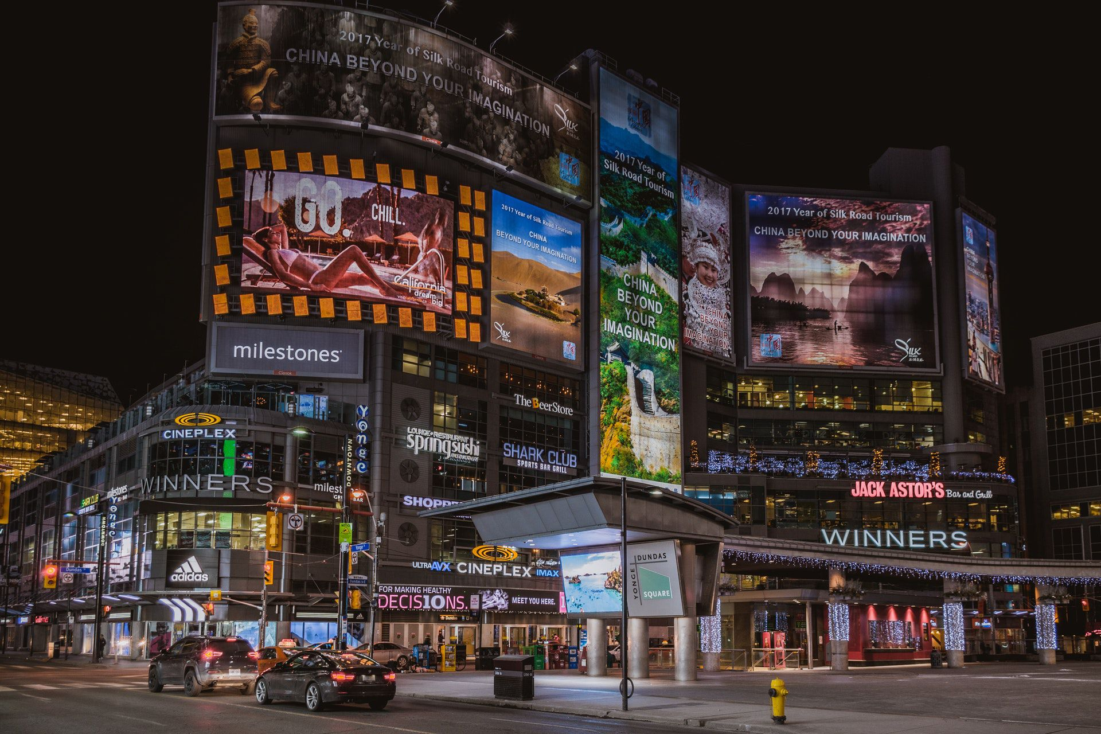
PART
01
Related Concept
Audio is a sequence of vibrations in varying pressure strengths. It consists of many Sines and Cosines.
Audio signals are signals that vibrate in the audible frequency range.
3 main attributes of audio:
Amplitude — loudness of the sound
Frequency — the pitch of the sound
Timbre — quality of the sound or the identity of the sound (e.g. The sound difference between a piano and a violin)

Slide 6
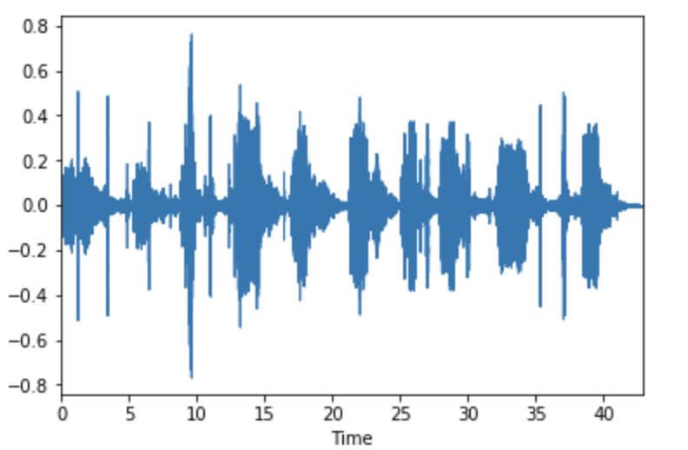
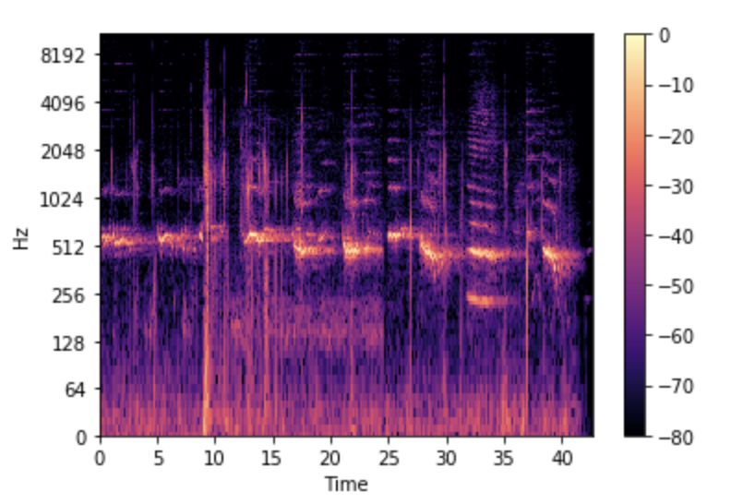
PART
01
Related Concept (cont)
How to Visualize An Audio?
Waveform
2) Spectrogram
Waveform plot only reflects the amplitude of audio (loudness).
Spectrogram can reflect the frequency of audio. It is Fourier Transform of the audio. Fourier Transform is a function that gets a signal in the time domain as input, and outputs its decomposition into frequencies.

Slide 7
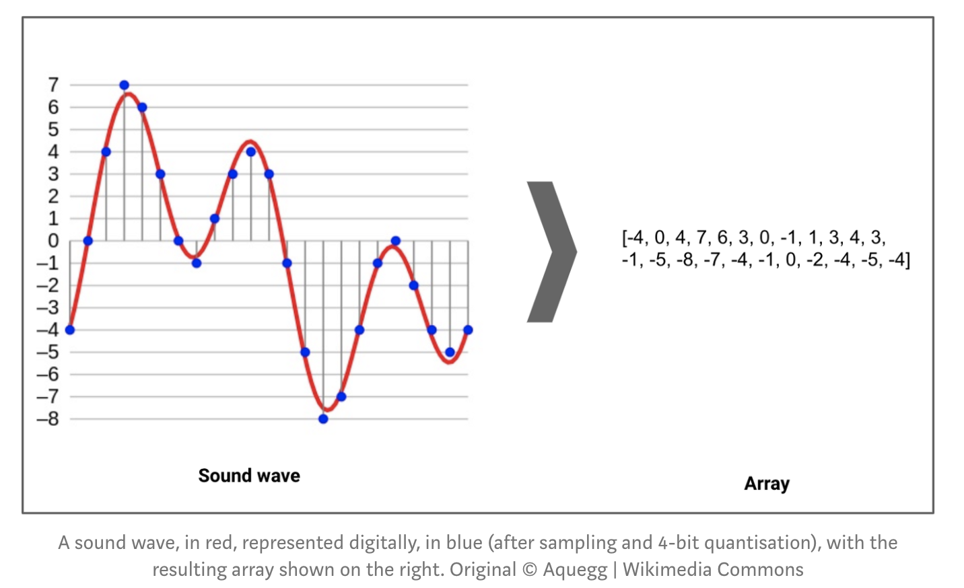
PART
01
Related Concept (cont)
How to transform audio file into numbers？
Sound waves are digitized by sampling them at discrete intervals known as the sampling rate (typically 44.1khz for CD quality audio meaning samples are taken 44,100 times per second).
Left chart shows how a waveform was turned into one dimensional array with amplitude values.
Right chart shows Spectrogram of amplitude values after Fourier Transformation
Note: Librosa is a Python package for music and audio processing and will allow us to load audio in our notebook as a numpy array for analysis and manipulation.

Slide 8
02
Exploratory Analysis

Slide 9
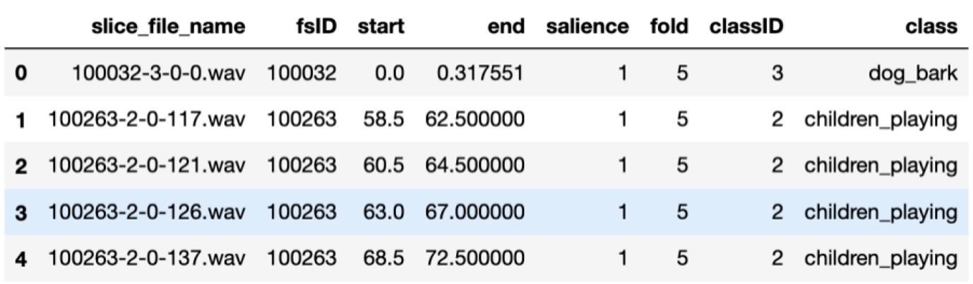
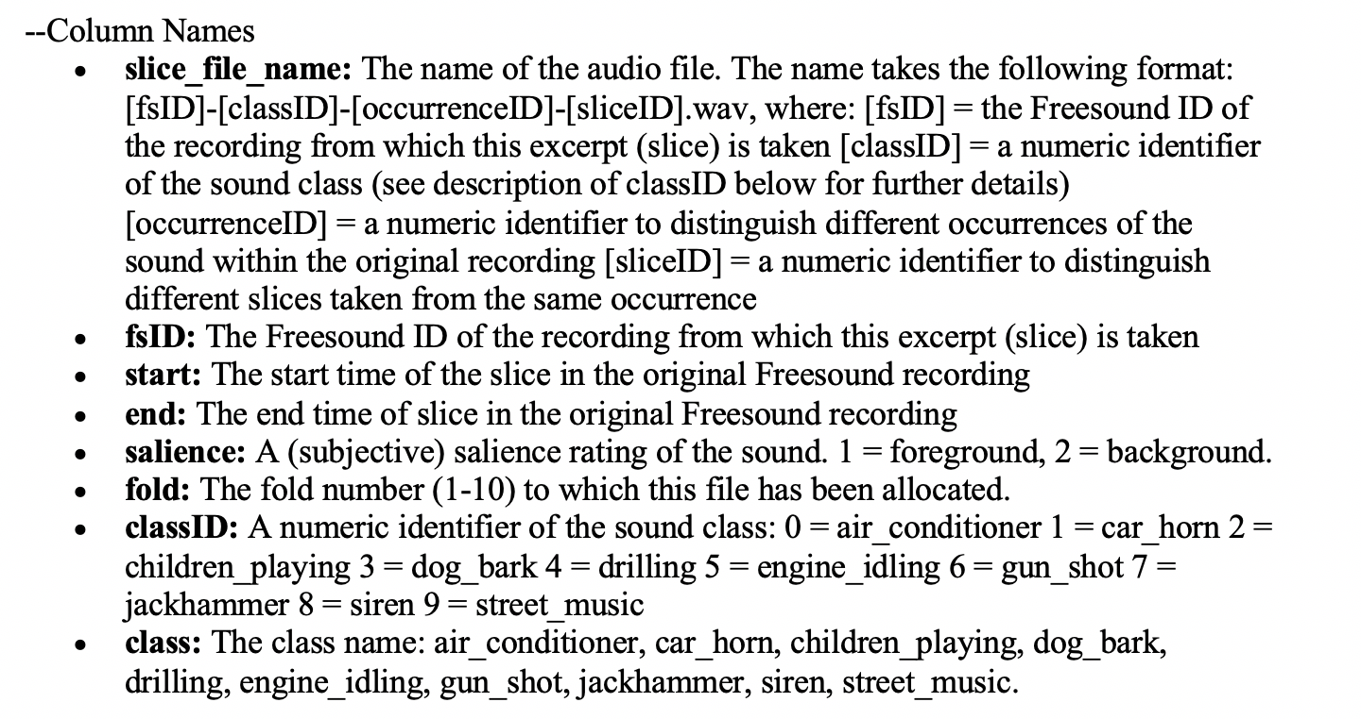
PART
02
Exploratory Analysis
Meta-data Glimpse
Columns explanation
Note: Urbansound8k.csv contains meta-data information about every audio file in the dataset.

Slide 10
PART
02
Exploratory Analysis (cont)
Some pitfalls on dataset
1. Use the predefined 10 folds and perform 10-fold cross validation
Reshuffling the data (e.G. Combine the data from all folds and generate a random train/test split) incorrectly place related samples in both the train and test sets, leading to inflated scores that don't represent model's performance on unseen data.
2. Don’t evaluate just on one split! Use 10-fold cross validation average scores
Models tend to obtain much higher scores when trained on folds 1-9 and tested on fold 10, compared to (e.G.) Training on folds 2-10 and testing on fold 1. For this reason, it is important to evaluate model on each of the 10 splits and report the average accuracy.

Slide 11
PART
02
Exploratory Analysis (cont)
Audio files included 8732 audio files of urban sounds (see description above) in WAV format. The files are pre-sorted into ten folds (folders named fold1-fold10).
Insight:
Most of sounds have different waveforms than others. While Siren, Jackhammer, Air_conditioner, and Engine_idling are kind of stable and similar. Amplitude values might not be a good feature.
Reflection:
Waveform plot only reflects the amplitude of audio(loudness).
Waveform plots of each audio class

Slide 12
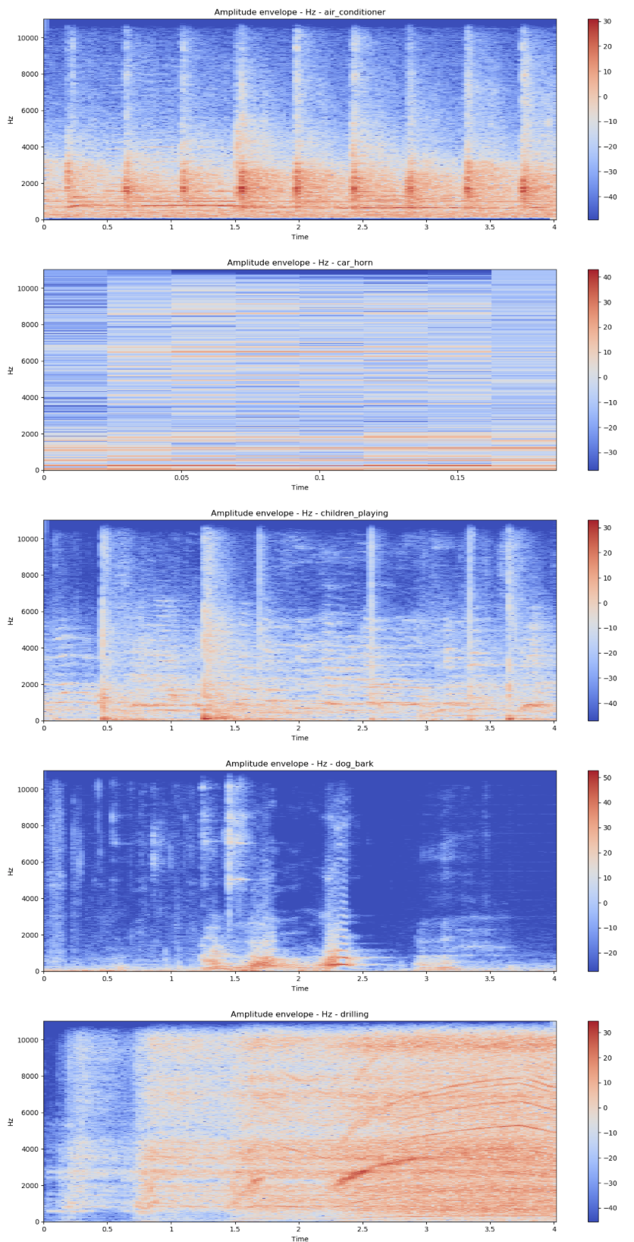
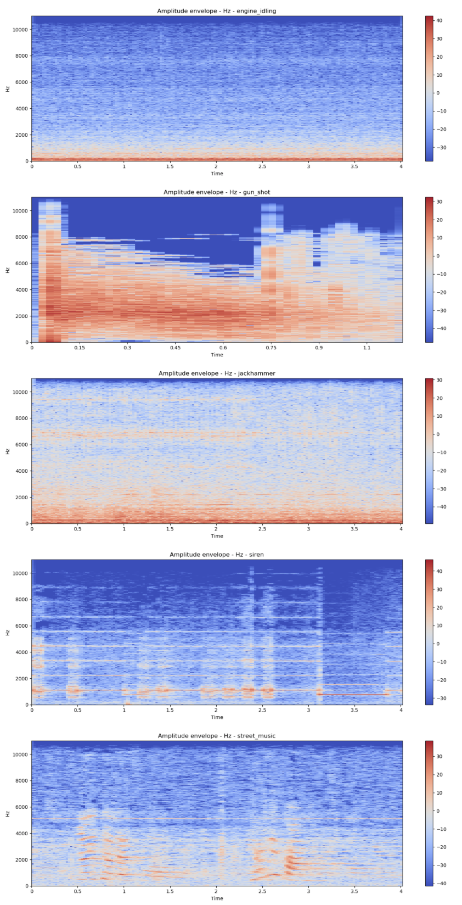
PART
02
Exploratory Analysis (cont)
Insights:
All kinds of sounds are quite different in frequency. Frequency is a very important and unique feature for a sound.
Reflection:
Spectrogram can reflect the frequency of audio. Audio is made by many Cosines and Sines.
Picture 5. Spectrograms of each audio class

Slide 13
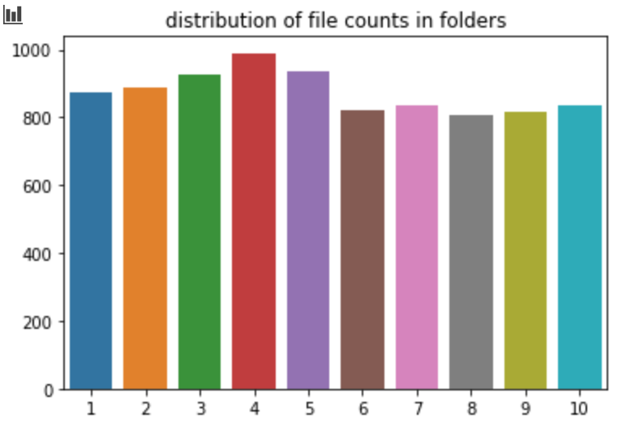
PART
02
Exploratory Analysis (cont)
Distribution of sound files in each folder
Insights: The number of files in each folder are quite similar, while folder 4 has the largest files. So we can definitely do cross validation on folder level.

Slide 14
PART
02
Exploratory Analysis (cont)
Introduction to Feature extracting
Mel frequency cepstral coefficient (MFCC)
MFCC divided the speech into frames (typically 20 ms for each frame), applied discrete Fourier Transformation over every frame, retained the logarithm of the amplitude spectrum, smoothed the spectrum, and applied discrete cosine transform.
Chroma features
Chroma features are an powerful representation for music audio in which the entire spectrum is projected onto 12 bins representing the 12 distinct semitones (or chroma) of the musical octave.
Cepstral coefficient (CC)
Cepstral coefficients are the inverse Fourier Transform representation of the log magnitude of the spectrum.
Linear prediction coefficient (LPC)
LPC consists of finding a time-based series of n-pole infinite impulse response (IIR) filters whose coefficients better adapt to the formants of a audio signal. The main idea behind LPC is that a sample of speech can be approximated as a linear combination of past audio samples.
Note: Those are very common audio features. However, I only chosen MFCC, Chroma features, and CC. Because the urban sounds tend to be nonlinear. Also, MFCC is more similar to how the human auditory system processes sounds.

Slide 15
PART
02
Exploratory Analysis (cont)
Reflections on Feature extracting
MFCC:
I extract the features on a per-frame basis using a window size of 20 ms and 50% frame overlap. I compute 40 Mel bands between 0 and 22050 Hz and keep the first 25 MFCC coefficients.
Chroma features:
I used three features, chroma_cqt(compute a chromagram from a constant-Q transform.), chroma_cens(computes the chroma variant “Chroma Energy Normalized” ), chroma_stft(compute a chromagram from an STFT spectrogram or waveform). All of them are computed 40 Mel bands between 0 and 22050 Hz and keep the first 25 coefficients.
Cepstral coefficient(CC):
I compute 40 Mel bands between 0 and 22050 Hz and keep the first 25 CC coefficients.

Slide 16
03
Model Selection

Slide 17
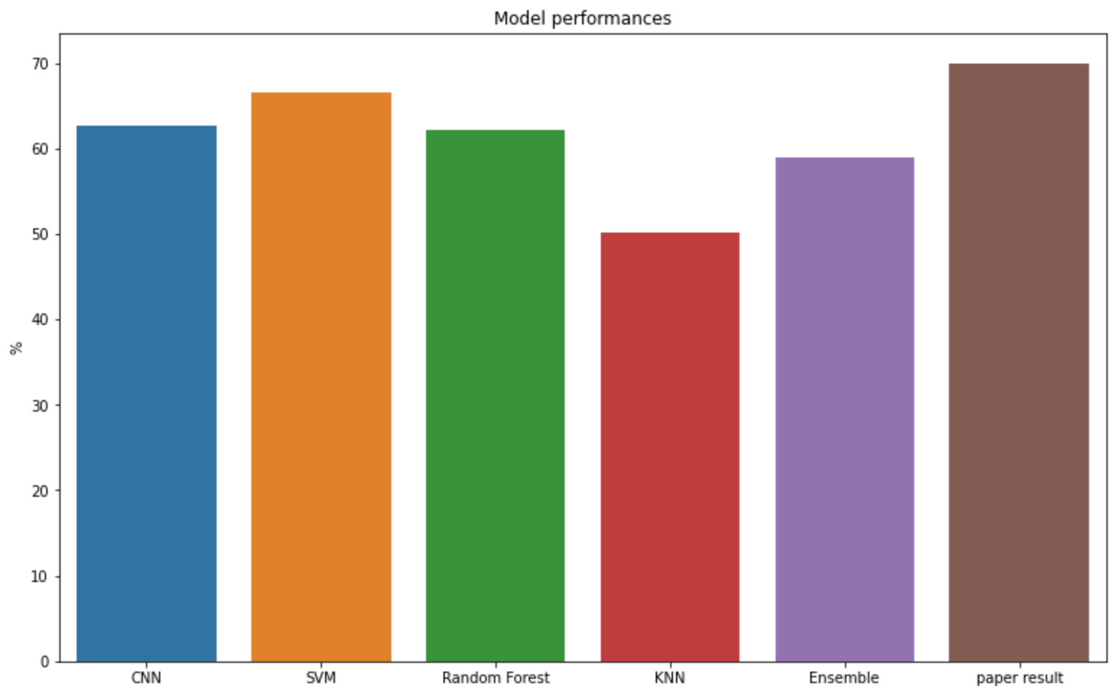
PART
03
Model Selection
Models performance (average score)
Used grid-search to find the best parameters
Used cross validation on folder level to deal with overfitting
Used 4 layers in CNN model
Used CNN, SVM, KNN, and Random Forest in Ensemble model to do soft majority voting
Note: Paper result is used to compare and comes from a recent published paper.

Slide 18
04
Result Interpretation
& Reflection

Slide 19
PART
04
Result Interpretation
SVM has the best performance and is relatively close to the paper’s accuracy
This is because features are nonlinearly tranformed, and RBF kernel in SVM is nonlinear
KNN has the lowest performance
Distance might be less meaningful for Fourier Transfomed features
Ensemble model’s performance is lower than most of models except KNN. (So weird to me)
Possible explanation
1) I didn’t use the best parameters for each model while doing ensemble
2) Some bad performance models might affect the result of ensemble models
3) More weights should be put on high performance models

Slide 20
PART
04
Result Reflection
Ensemble model doesn’t work all the time if handle inappropriately
Especially the features, even though there are lost of commonly used features, but for different sounds, those features might not work very well.
We can generate different features for different kind of sound groups to get better performance. However, generating new features requires domain knowledge and high-level math skills, which is hard for me.
This is my first time to work on audio file, I found it quite interesting and there’s a lot I need to learn If I want to dig deeper.

Slide 21
Thank you!
Jie Tang
May 8 2020

